Slide 1
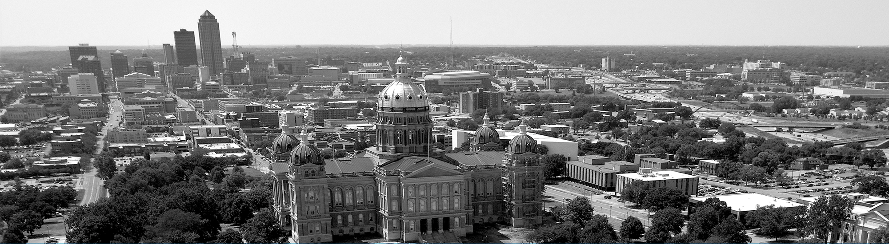

Winter 2022-2023
Advocacy Presentation

Slide 2


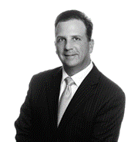
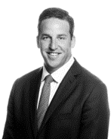
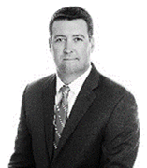
Cornerstone Government Affairs
Cornerstone’s Des Moines, Iowa office opened its doors in May 2010 and currently includes a team comprised of David Adelman, Sara Allen, Lillie Brady, Frank Chiodo and Matt Hinch. Our Iowa staff brings over 100 years of experience in Iowa politics and policy, while each professional brings their own expertise in diverse fields ranging from health care to tax.
We provide clients a broad and diverse range of services that are based on significant experience, broad expertise and solid working relationships throughout the state government, including:
Agriculture & Rural Development
Economic Development & Tourism
Education
Energy & Environment
Financial Services
Health
Public Safety
State Appropriations & Budget
Tax Policy
Technology & Telecommunications
Transportation & Infrastructure

Slide 3
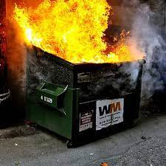
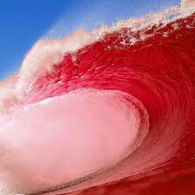
Iowa State Election Results 2022
Key Takeaways
Iowa Republicans maintain control of the state legislature
All of Iowa's four Congressional seats are now held by Republicans
Kim Reynolds cruises to victory in her second term as Governor winning by a margin of 19%
The longest serving Attorney General and State Treasurer in the country lost both of their reelection bids to their Republican challenger
VS.
Iowa Senate Composition
34 Republicans
16 Democrats
Iowa House Composition
64 Republicans
36 Democrats

Slide 4

2023 Legislative Breakdown: The Iowa Legislature
Governor Kim Reynolds
Senate: 34 Republicans, 16 Democrats
House: 64 Republicans, 36 Democrats

Slide 5
2023 General Assembly
New Chairs:
Senate:
Agriculture – Sen. Dawn Driscoll (R-Williamsburg)
Appropriations – Sen. Tim Kraayenbrink (R-Ft. Dodge)
Commerce – Sen. Waylon Brown (R-Osage)
Education – Sen. Ken Rozenboom (R-Pella)
Ethics – Sen. Tom Shipley (R-Nodaway)
Government Oversight – Sen. Amy Sinclair (R-Allerton)
Health and Human Services – Sen. Jeff Edler (R-State Center)
Human Resources has been renamed Health and Human Services
Judiciary – Sen. Brad Zaun (R-Urbandale)
Natural Resources and Environment – Sen. Annette Sweeney (R-Alden)
Rules and Administration – Sen. Jack Whitver (R-Ankeny)
State Government – Sen. Jason Schultz (R-Schleswig)
Technology – Sen, Chris Cournoyer (R-LeClaire)
The Technology Committee will focus on information technology, telecommunications, cybersecurity, and other related policies
Transportation – Sen. Mike Klimesh (R-Spillville)
Veterans Affairs – Sen. Jeff Reichman (R-Montrose)
Ways and Means – Sen. Dan Dawson (R-Council Bluffs)
Workforce– Sen. Adrian Dickey (R-Packwood)
The Labor Committee has been renamed the Workforce Committee
Appropriations:
Administration and Regulation – Sen Dave Rowley (R-Spirit Lake)
Agriculture and Natural Resources – Sen. Dan Zumbach (R-Ryan)
Economic Development – Senator Lofgren (R-Muscatine)
Education – Sen. Jeff Taylor (R-Sioux Center)
Health and Human Services – Sen. Mark Costello (R-Imogene)
Justice Systems – Sen. Julian Garrett (R-Indianola)
Transportation, Infrastructure and Capitals – Sen. Carrie Koelker (R-Dyersville)
Other Committee Chair Assignments:
Administrative Rules Review – Sen. Mike Klimesh, vice chair
International Relations – Sen. Annette Sweeney, vice chair
Public Retirement Systems – Senator Kraayenbrink, co-chair

Slide 6
2023 General Assembly
New Chairs:
House:
Admin and Rules – Rep. Megan Jones (R-Sioux Rapids)
Appropriations – Rep. Gary Mohr (R-Bettendorf)
Commerce - Rep. Shannon Lundgren (R-Peosta)
Economic Growth - Rep. Ray Sorensen (R-Greenfield)
State Government – Rep. Jane Bloomingdale (R- Northwood)
Agriculture – Rep. Mike Sexton (R-Sioux Rapids)
Education – Rep. Skylar Wheeler (R-Hull)
Education Reform - Rep. Pat Grassley (R-New Hartford)
The Education Reform Committee will be a 5-person committee dealing with bills containing significant reforms to our educational system
Government Oversight – Rep. Brooke Boden (R-Indianola)
Natural Resources – Rep. Tom Jeneary (R-Le Mars)
Public Safety – Rep. Phil Thompson (R-Jefferson)
Veterans Affairs – Rep. Chad Ingels (R-Randalia)
Environmental Protection - Rep. Dean Fisher (R-Montour)
Ethics - Rep. Anne Osmundson (R- Volga)
Human Resources - Rep. Ann Meyer (R-Fort Dodge)
International Relations – Rep. Eddie Andrews (Johnston)
House Judiciary - Rep. Steve Holt (R-Denison)
Labor - Rep. Dave Deyoe (R-Nevada)
Local Government - Rep. Shannon Latham (R-Sheffield)
Transportation - Rep. Brian Best (R-Glidden)
Appropriations Subcommittees:
Administration and Regulation Appropriations - Rep. Michael Bergan (R-Dorchester)
Agriculture and Natural Resources Appropriations - Rep. Norlin Mommsen (R-DeWitt)
Economic Development Appropriations - Rep. Martin Graber (R-Fort Madison)
Education Appropriations - Rep. Carter Nordman (R-Panora)
Health and Human Services Appropriations - Rep. Joel Fry (R-Osceola)
Justice Systems Appropriations - Rep. Brian Lohse (R-Bondurant)
Transportation, Infrastructure, and Capitals Appropriations - Rep. Jacob Bossman (R-Sioux City)

Slide 7
Tourism in Iowa
Increased tourism investment will lead to a healthier economy and a strong workforce for the entire state.
Visitor Spending
Reached $4.6 billion in 2020, a 29% decline over 2019 (covid impact). $12.5 million was spent every day by visitors in Iowa.
Travel Generated Payroll
2020 tourism generated $1.50 billion, a 3.6% increase.
Travel Generated Employment
Tourism in 2020supported a total of 60,218 jobs, 4.8% of total employment in Iowa.
Travel Generated Tax Receipts
The $864 million instate and local taxes generated by tourism would cover the average salaries of over 15,000 public school teachers in Iowa.
State Tourism Budgets
The Iowa Tourism Office, a division of Iowa Economic Development Authority, budget ranks #38. Of the 45 states reporting state tourism budgets, only seven other states had lower tourism budgets than Iowa (2021).

Slide 8


Slide 9
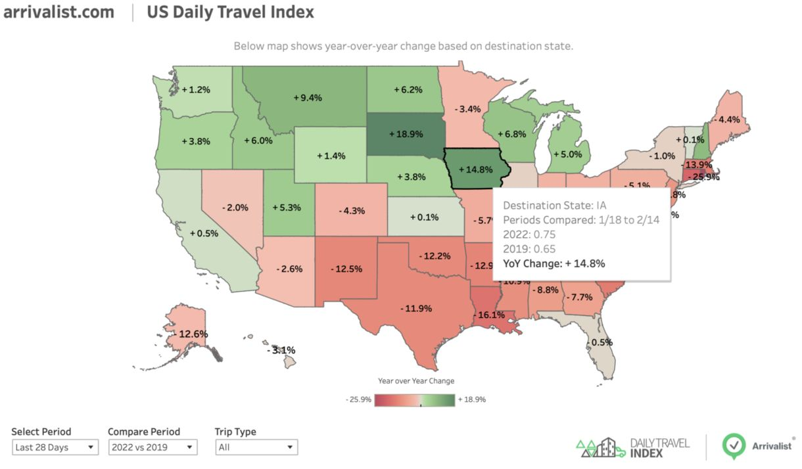
YOUR WORK PAYS OFF!

Slide 10
Legislative Priorities

Slide 11
Maintain or Increase $$$ for Tourism Initiatives
Tourism experienced a record year by receiving over $50.70 M in appropriations in 2022. Over $30.5 M of that was new funding to be used for the creation of new tourism resources and bolster current programming. iTIP will ensure those appropriations are maintained in the FY24 budget.
$1.1 million was appropriated to the Iowa Economic Development Authority (IEDA) for Tourism Advertising and Strategic Plan outreach that will implement the Authority's 2022 strategic plan for tourism and travel. We look forward to partnering with IEDA on this rollout and implementation.
Maintain the $1.5 million appropriation to IEDA for the Tourism Marketing office.
Maintain the $1million from RIIF & $150,000 from EcoDevo budget for the Iowa Great Places Initiative
Maintain the $10million from the RIIF to the IEDA for the Community Attraction and Tourism (CAT) Fund.
Maintain the $500,000 for the Regional Sport Authority Districts (RSAD) that promote youth sports, high school athletics, the Special Olympics, or other nonprofessional sporting events.
Maintain the $5million for State Park Improvements.

Slide 12
Protect School Start Date
Support Iowa’s current earliest school start date of August 23 to allow the tourism industry to generate revenue to pay for education. In 2020, tourism generated $864 million in state and local tax revenues which support the state’s education system.
In 2021, tourism generated $1.0 billion in state and local tax revenues which support the state’s education system.

Slide 13
Iowa Water Land Legacy Trust Fund
IWILL (Iowa Land and Legacy) will fund tourism and quality of life components that showcase Iowa’s beauty and improves Iowa workforce efforts.
Fund the Trust to support programs including:
Lake restoration
Resource Enhancement and Protection Program (REAP)
State Recreational Trails Program
DNR funding
Use of Iowa’s parks, trails, and open spaces more than doubled
State park visits saw a record 16.6 million visits
Fishing license sales increased 21%
Hunting license sales increased 11%
Thousands of bikes, kayaks and canoes purchased led to a supply shortage for retailers
http://www.iowaswaterandlandlegacy.org/wp-content/uploads/2019/02/IWILL-Benefits-Econ-Dev.pdf

Slide 14
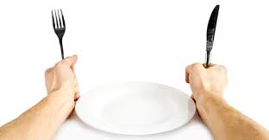
If You’re Not at the Table…

Slide 15
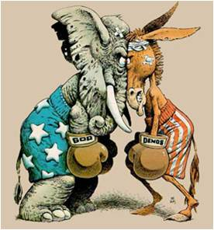
Finding Your Voice in Government: The Role You Can Play

Slide 16
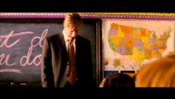

Slide 17
Who are we? What is iTIP
Iowa Travel Industry Partners (iTIP) is a statewide non-profit that is a resource and champion for the Iowa travel industry. Numerous focus groups, presentations and the development of a steering committee led us to July 2021, when we began accepting memberships and operating programming.
Our mission is to be the unified driving force for the travel and tourism industry, promoting Iowa and its communities.
The organization strives to positively impact the economy and quality of life for all Iowans – and to make Iowa a premier destination of choice.

Slide 18
Why Is Advocacy Important?
It is an open process that invites public participation
Lawmakers expect people to bring ideas to them, they don’t always seek them out
They expect constituents to come in and talk to them about relevant issues, and their offices are staffed for this function
Almost on every issue there will be someone advocating for one side or the other. (Squeaky wheel does get the oil often)

Slide 19
Why You?
Members want to hear about what is happening in their state/district
They expect constituents to come in and talk to them about local issues
You can shape the debate by providing objective, FACTUAL, non-partisan information and analysis
You are the expert
You are a trusted voice in the state
Your work is a source of pride to officials

Slide 20
The Citizen Lobbyist
Your advantage: you are a constituent
You have credibility that professional lobbying firms do not
An elected official’s reputation depends on listening to constituents like you
As a concerned Iowan, you have a powerful message

Slide 21
Ways to Lobby
Traditional lobbying
Talking to a legislator + Asking for specific action on a specific piece of legislation = Specific result
“Senator Smith, please vote yes on S.F.123 which would give all Iowans free Ben and Jerry’s ice cream for the rest of their lives.”

Slide 22
Ways to Lobby
Grassroots lobbying
Talking to another citizen+ Asking them to talk to a legislator about taking specific action on a specific piece of legislation = Specific result
“Anyone who lives in Polk County, please call Senator Smith and ask her to vote yes on S.F. 123 which would give all Iowans free Ben and Jerry’s ice cream for the rest of their lives.”

Slide 23
Ways to Lobby
Advocacy
Talking to anyone + stating your position on legislation OR giving general information on an issue = could encourage them to take action
“’Iowans for Free Ice Cream’ supports S.F 123, which would give free Ben and Jerry’s ice cream to all Iowans for the rest of their lives.”
Radio Iowa

Slide 24
Principles of Lobbying
Speak from the heart
Tell your story
You will say the most passionate thing the legislator hears all day
Stories are easier to remember than pre-scripted statements
Ask for one thing and stay focused
Ask the legislator to vote a specific way before you end the conversation
Be prepared (more later)
Use the facts (more later)

Slide 25
Citizen Visit
Before the meeting
Be prepared for questions
Be prepared for challenges
Anticipate the arguments of your opponents
Address opposition openly and without being defensive
Address opposing arguments early in discussion
If you are meeting as a group, designate one spokesperson
Have nametags for everyone in the group

Slide 26
Citizen Visit
In the meeting
Present a clear message
Make your point with as few words as possible
Say exactly what you want the legislator to do
Use language pre-determined by your organization or your own prepared words (include your personal story)
If a question throws you off balance because you don’t know the answer
Say you don’t know the answer
Tell them you will research the matter and get back to them
Be a good listener
Give the staff or legislator an opportunity to express their view

Slide 27
Citizen Visit
Concluding the meeting
Ask the legislator to take specific action
Include bill number if it regards a specific bill
One person should ask the “pin down” question
Thank legislator for taking time to listen to your point of view OR
Thank staff member for communicating your view to their boss
Ask for written reply if you want one

Slide 28
Do’s of Advocacy
Review logistics: When, where and with whom.
Rehearse informally with your team.
Be punctual, patient and flexible.
Be prepared to provide additional information.
Be clear about your priorities, manage expectations.
If you are a registered voter in their district, say so.
Hit only the highlights: know your message and organize yourself to cover a small number of key points.
Be sensitive to their time.
Share who you work with that the Member may recognize.
Allow time for questions.
Listen. What you hear is as important as what you say.

Slide 29
Dont’s of Advocacy
Show up late.
Forget your documents, business cards, etc.
Spend too much time on the introductions.
Be dishonest or provide unverified statistics/information.
Make up an answer that you are unsure of. Tell them you will get back to them after the meeting.
Provide a long, comprehensive and in-depth speech about the issue.
Jump around from issue to issue.
Use acronyms or jargon.
Tell someone they are wrong.
Forget to send a follow-up email!

Slide 30
2023 Legislative Calendar
Advocacy Webinar 1/4/2023
First day of session- January 9th
iTIP Legislative Reception- January 17th
First funnel – March 3rd (Friday of the 8th week)
Second Funnel- March 31st (Friday of the 12th week)
Last day of session- April 28th (110 day per diem)

Slide 31


Slide 32

Questions?

